Slide 1
Bread making in Ancient Rome
How bread was made?

Slide 2
Index
Who knows the answers?
The recipe
The bread making process
Milling and baking (pictures)
More to learn
Some questions & answers
Glossary and IRL

Slide 3
Who knows the answers?
What does it mean “Panem et circences”?
Can you explain why bread was so important in Roman times?

Slide 4
The recipe
Yeast (Romans kept the sour dough, soaked it in water and used it as a starter for new dough)
Salt (or seawater)
Water
Flour

Slide 5
Bread making process
The grain was ground into flour.
Flour was mixed with water, salt and yeast.
They mixed the dough. The dough was kneaded.
The dough was formed into loaves and baked.

Slide 6
Milling and baking
In town:
There were bakeries, so bread was sold in them.
Milling was also done by the baker.
Some people brought the wheat to the baker and grain was converted into flour and baked the bread.
Others converted the grain into flour by hand.
In the country:
Milling was done at home by hand.
People made bread at home.

Slide 7
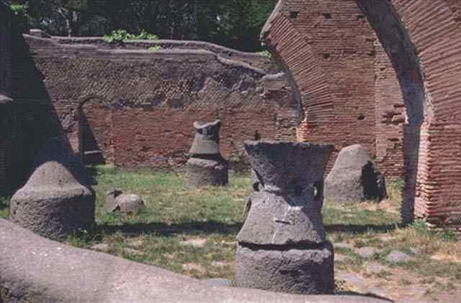
Mills in Pompei

Slide 8
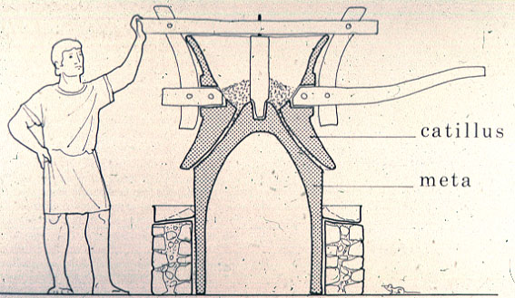

Slide 9
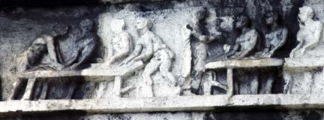
Bread making relief

Slide 10
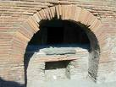
An oven in Pompeii

Slide 11
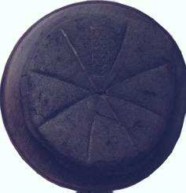
Charred (burnt) loaf of bread found in an oven in Pompeii (Italy) (from A Taste of Ancient Rome, IIaria Gozzini )

Slide 12
More to learn
The word salary comes from the Latin word for salt, sal, because Roman soldiers were often paid in salt.
In Roman days, milling and bread baking were done on the same place, the miller and the baker were the same person.
In towns there were bakeries, but in the country most people made bread at home.

Slide 13
Some questions
Can you list the bread making ingredients?
What were the two jobs of the baker?
Were there bakeries in the country?
What was the most important food in Rome?

Slide 14
Answers
Yeast, salt, water, flour.
Milling and bread baking.
No.
Bread.

Slide 15
Glossary
Dough: a mixture of flour and water, that is kneaded and baked, especially as bread.
Loaf: a shaped mass of bread baked in one piece.
Mill: a building with machinery for grinding grain into flour.
Wheat: a cereal.
Yeast: a ferment.
VERBS
To char: to burn.
To knead: to mix and work a mass.
To mix: to add an ingredient to another.
To soak: to immerse in liquid.
To grind: reduce to powder by crushing.

Slide 16
IRL Digital Internet Reference
http://www.dl.ket.org/latin2/mores/food/breadmaking/baking.htm
http://www.unc.edu/courses/rometech/public/content/survival/bread.html
http://www.yourdictionary.com/ahd/d/d0359900.html

